Slide 1
Learning Python
20220928

Slide 2
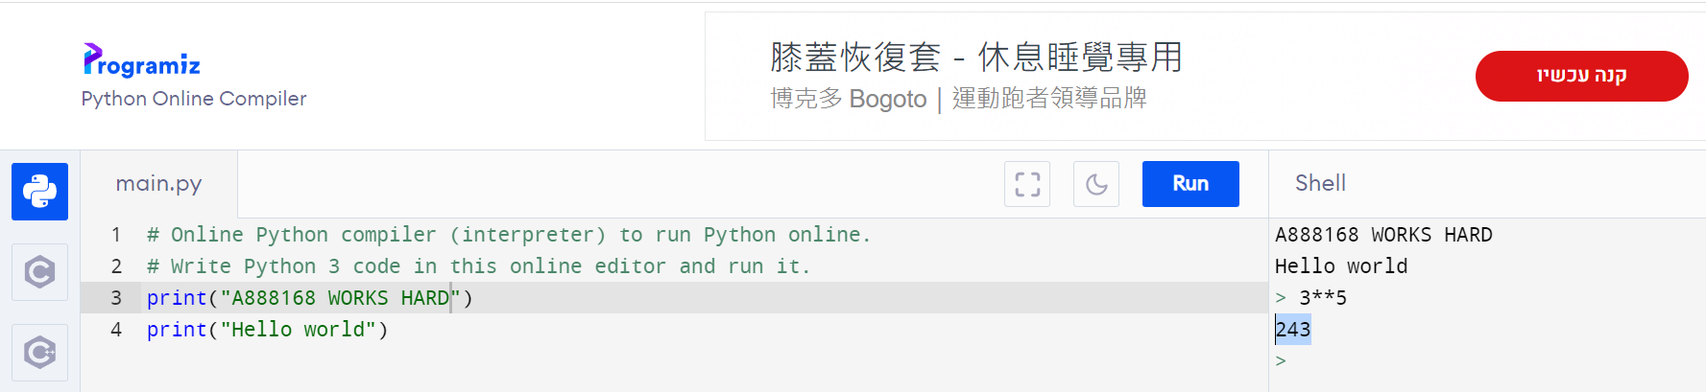
Python Online Interpreter:1
INTERACTIVE

Slide 3
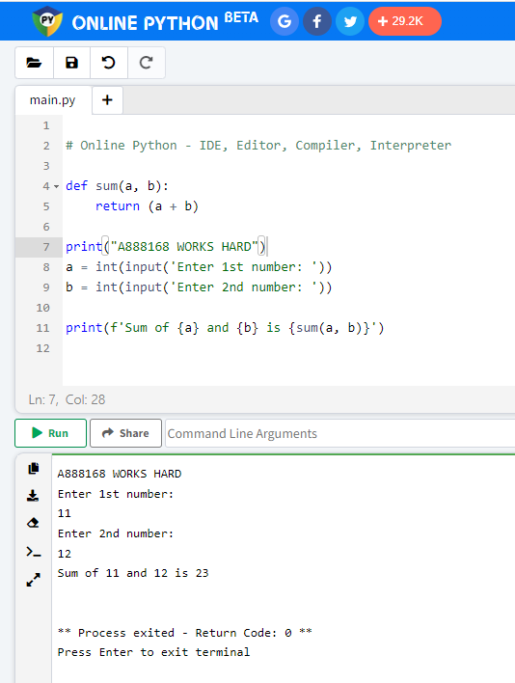
Python Online Interpreter:2

